Slide 1
Unit-3, Part-1 Big Data

Slide 2
Big Data : Key-value Stores and Semi structured Data, using JSON and MongoDB, or other combinations

Slide 3
Motivation
Very large volumes of data being collected
Driven by growth of web, social media, and more recently internet-of-things
Web logs were an early source of data
Analytics on web logs has great value for advertisements, web site structuring, what posts to show to a user, etc
Big Data: differentiated from data handled by earlier generation databases
Volume: much larger amounts of data stored
Velocity: much higher rates of insertions
Variety: many types of data, beyond relational data

Slide 4
Big Data Storage Systems
Key-value storage systems
Key-value stores are distributed hash tables (DHTs)
Key-value storage systems store large numbers (billions or even more) of small (KB-MB) sized records.
In a key-value store, a key binds to a specific value and doesn’t assume anything about the structure of the value. A value can be a blob, image, server name, or anything the user wants to store against a unique key.
We can put large data in the blob store and put links to that data in the value field.
Examples of key-value store usage include bestseller lists, shopping carts, customer preferences and product catalogs.
Notes:
Many real-world services like Amazon, Facebook, Instagram, Netflix, and many more use primary-key access to a data store

Slide 5
Key Value Storage Systems
Records are partitioned across multiple machines and
Queries are routed by the system to appropriate machine
Records are also replicated across multiple machines, to ensure availability even if a machine fails
Key-value stores ensure that updates are applied to all replicas, to ensure that their values are consistent

Slide 6
Key Value Storage Systems
Key-value stores may store
uninterpreted bytes, with an associated key
E.g., Amazon S3, Amazon Dynamo
Wide-table (can have arbitrarily many attribute names) with associated key
Google BigTable, Apache Cassandra, Apache Hbase, Amazon DynamoDB
Allows some operations (e.g., filtering) to execute on storage node
JSON
MongoDB, CouchDB (document model)
Document stores store semi-structured data, typically JSON
Some key-value stores support multiple versions of data, with timestamps/version numbers

Slide 7
Data Representation
An example of a JSON object is:
{
"ID": "22222",
"name": {
"firstname: "Albert",
"lastname: "Einstein"
},
"deptname": "Physics",
"children": [
{ "firstname": "Hans", "lastname": "Einstein" },
{ "firstname": "Eduard", "lastname": "Einstein" }
]
}

Slide 8
Key Value Storage Systems
Key-value stores support
put(key, value): used to store values with an associated key,
get(key): which retrieves the stored value associated with the specified key
delete(key) -- Remove the key and its associated value
Document stores also support queries on non-key attributes
See book for MongoDB queries
Key value stores are not full database systems
Have no/limited support for transactional updates
Applications must manage query processing on their own
Not supporting above features makes it easier to build scalable data storage systems
Also called NoSQL systems

Slide 9
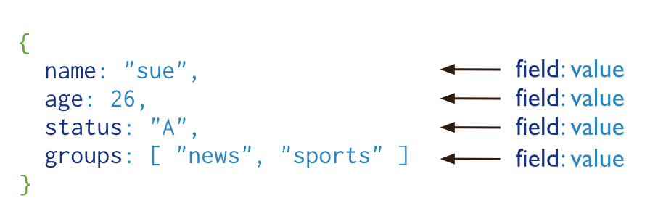
Introduction to MongoDB
A record in MongoDB is a document, which is a data structure composed of field and value pairs.
MongoDB documents are similar to JSON objects.
The values of fields may include other documents, arrays, and arrays of documents

Slide 10
Introduction to MongoDB
MongoDB stores documents in collections. Collections are analogous to tables in relational databases.
BSON is a binary serialization format used to store documents

Slide 11
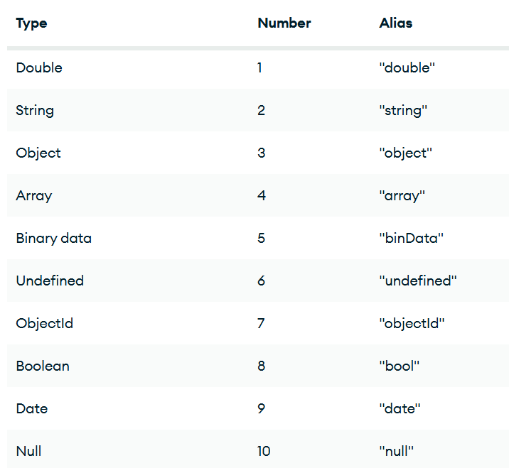
Introduction to MongoDB
Each BSON type has both integer and string identifiers as listed in the following table

Slide 12
Introduction to MongoDB
The $type operator supports using these values to query fields by their BSON type. $type also supports the number alias,
Create or insert operations add new documents to a collection. If the collection does not currently exist, insert operations will create the collection.
MongoDB provides the following methods to insert documents into a collection:
db.collection.insertOne()
db.collection.insertMany()

Slide 13
Introduction to MongoDB
db.collection('inventory').insertOne({
item: 'canvas',
qty: 100,
tags: ['cotton'],
size: { h: 28, w: 35.5, uom: 'cm' }
});
db.collection('inventory').insertMany([
{
item: 'journal',
qty: 25,
tags: ['blank', 'red'],
size: { h: 14, w: 21, uom: 'cm' }
},
{
item: 'mousepad',
qty: 25,
tags: ['gel', 'blue'],
size: { h: 19, w: 22.85, uom: 'cm' }
}
]);

Slide 14
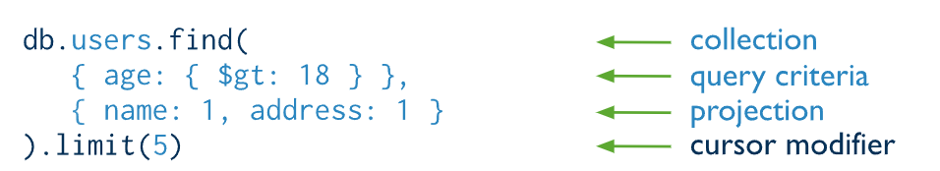
Introduction to MongoDB
MongoDB provides the following methods to read documents from a collection:
db.collection.find()
You can specify query filters or criteria that identify the documents to return.

Slide 15
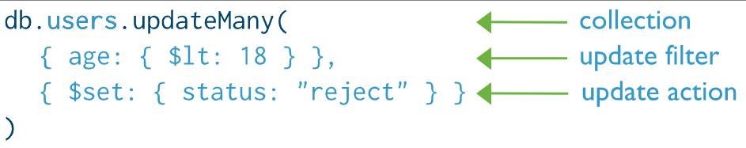
Introduction to MongoDB
Update operations modify existing documents in a collection. MongoDB provides the following methods to update documents of a collection:
db.collection.updateOne()
db.collection.updateMany()
db.collection.replaceOne()
we can specify criteria, or filters, that identify the documents to update.

Slide 16
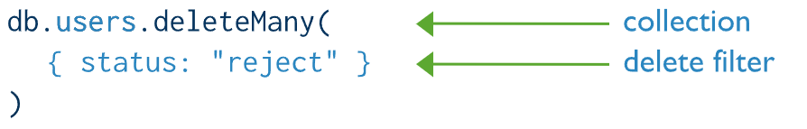
Introduction to MongoDB
Delete operations remove documents from a collection. MongoDB provides the following methods to delete documents of a collection:
db.collection.deleteOne()
db.collection.deleteMany()

